Slide 1
MSE testing
Grant Adams

Slide 2
Fitting OMs
library(Rceattle) data("NorthernRockfish2022") nrdata <- NorthernRockfish2022 nrdata$fleet_control$proj_F_prop <- 1 om <- Rceattle::fit_mod( data_list = nrdata, estimateMode = 0, # Estimate initMode = 1, # Assume unfished equilibrium phase = TRUE, M1Fun = build_M1( updateM1 = TRUE, M1_model = 1, M1_use_prior = TRUE, M_prior = 0.06, M_prior_sd = 0.05) )
[1] "'Age_max_selected_upper' not specified in 'fleet_control', assuming 'NA'" [1] "'Sel_curve_pen1' not specified in 'fleet_control', assuming '0'" [1] "'Sel_curve_pen2' not specified in 'fleet_control', assuming '0'"

Slide 3
Fitting EMs (Tier 3 HCR)
em <- Rceattle::fit_mod( data_list = nrdata, estimateMode = 0, # Estimate verbose = 1, phase = TRUE, initMode = 1, # Assume unfished equilibrium M1Fun = build_M1( updateM1 = TRUE, M1_model = 1, M1_use_prior = TRUE, M_prior = 0.06, M_prior_sd = 0.05), HCR = build_hcr(HCR = 5, # Tier3 HCR Ftarget = 0.4, # F40% Flimit = 0.35, # F35% Plimit = 0.2, # No fishing when SB<SB20 Alpha = 0.05) )
[1] "'Age_max_selected_upper' not specified in 'fleet_control', assuming 'NA'" [1] "'Sel_curve_pen1' not specified in 'fleet_control', assuming '0'" [1] "'Sel_curve_pen2' not specified in 'fleet_control', assuming '0'"

Slide 4
Running MSEs
mse1 <- run_mse( om = om, em = em, nsim = 10, assessment_period = 2, sampling_period = c(1, 2) # Fishery = fleet 1, BTS = fleet 2 )

Slide 5
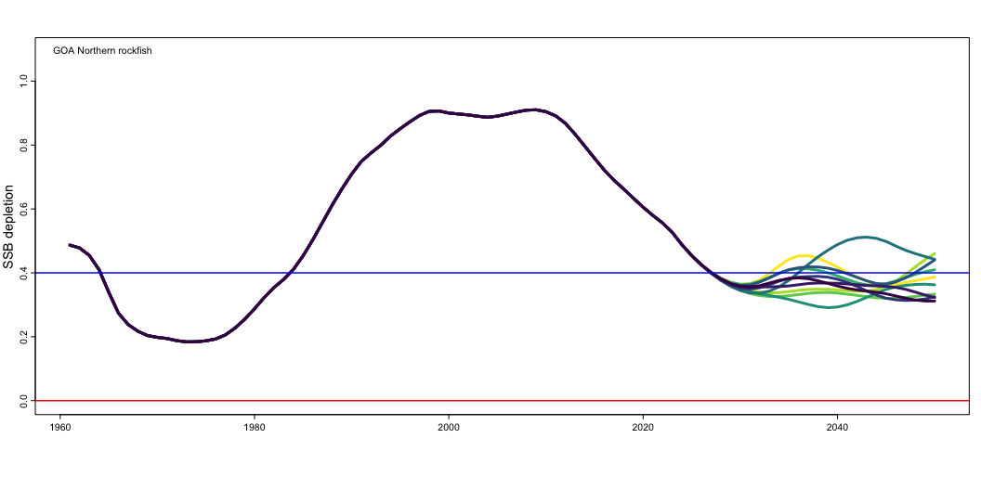
Evaluating MSEs via plots
plot_depletionSSB(lapply(mse1, function(x) x$OM))

Slide 6
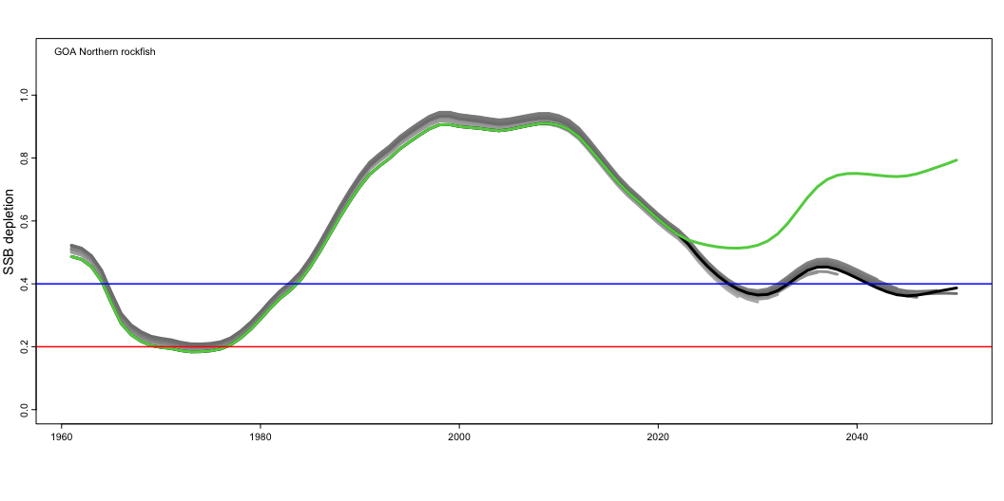
plot_depletionSSB( c(mse1$Sim_1$EM, # EMs list(mse1$Sim_1$OM, # OM mse1$Sim_1$OM_no_F # OM w/ no fishing )), line_col = c( paste0("grey", round(seq(80, 50, length.out = 15))), 1, 3 ) )

Slide 7
Species | Fleet_name | Fleet_code | Average Catch | Catch IAV | P(Closed) | Avg SSB Relative MSE | Avg terminal SSB Relative MSE | EM: P(Fy > Flimit) | EM: P(SSB < SSBlimit) | OM: P(Fy > Flimit) | OM: P(SSB < SSBlimit) | EM: P(Fy > Flimit) but OM: P(Fy < Flimit) | EM: P(Fy < Flimit) but OM: P(Fy > Flimit) | EM: P(SSB < SSBlimit) but OM: P(SSB > SSBlimit) | EM: P(SSB > SSBlimit) but OM: P(SSB < SSBlimit) | OM: Terminal B | OM: Terminal SSB | OM: Terminal Dynamic SB0 | OM: Terminal SSB Depletion | OM: Terminal SSB Depletion (Dynamic) | OM: Average SSB Depletion | OM no F: SSB Collapse | OM: SSB Collapse | OM: SSB Collapse from F
GOA Northern rockfish | NA | NA | 4546.83 | 0.07 | 0 | 0.45 | 0 | 0 | 0 | 0 | 0 | 0 | 0 | 0 | 0 | 110019 | 35363.29 | 78239.95 | 0.38 | 0.45 | 0.39 | 0 | 0 | 0
1 | Fishery | 2 | 4546.83 | 0.07 | 0 | NA | NA | NA | NA | NA | NA | NA | NA | NA | NA | NA | NA | NA | NA | NA | NA | NA | NA | NA
All | All | All | 4546.83 | 0.07 | NA | NA | NA | NA | NA | NA | NA | NA | NA | NA | NA | NA | NA | NA | NA | NA | NA | NA | NA | NA
Summary statistics
library(kableExtra) mse_summ <- mse_summary(mse1) kable(mse_summ, digits = 2)

Slide 8
Alternative scenarios

Slide 9
Different BRPs
em2 <- Rceattle::fit_mod( data_list = nrdata, estimateMode = 0, # Estimate verbose = 1, phase = TRUE, initMode = 1, # Assume unfished equilibrium M1Fun = build_M1( updateM1 = TRUE, M1_model = 1, M1_use_prior = TRUE, M_prior = 0.06, M_prior_sd = 0.05), HCR = build_hcr(HCR = 5, # Tier3 HCR Ftarget = 0.30,# F40% Flimit = 0.10, # F35% Plimit = 0, # No limit Alpha = 0.1) )
[1] "'Age_max_selected_upper' not specified in 'fleet_control', assuming 'NA'" [1] "'Sel_curve_pen1' not specified in 'fleet_control', assuming '0'" [1] "'Sel_curve_pen2' not specified in 'fleet_control', assuming '0'"

Slide 10
MSE 2
mse2 <- run_mse( om = om, em = em2, nsim = 10, assessment_period = 2, sampling_period = c(1, 2) # Fishery = fleet 1, BTS = fleet 2 )

Slide 11
Triannual BTS
mse3 <- run_mse( om = om, em = em, nsim = 10, assessment_period = 2, sampling_period = c(1, 3) # Fishery = fleet 1, BTS = fleet 2 )

Slide 12
4-year cycle and 50% sampling
mse4 <- run_mse( om = om, em = em, nsim = 10, fut_sample = 0.5, assessment_period = 4, sampling_period = c(1, 2) # Fishery = fleet 1, BTS = fleet 2 )

Slide 13
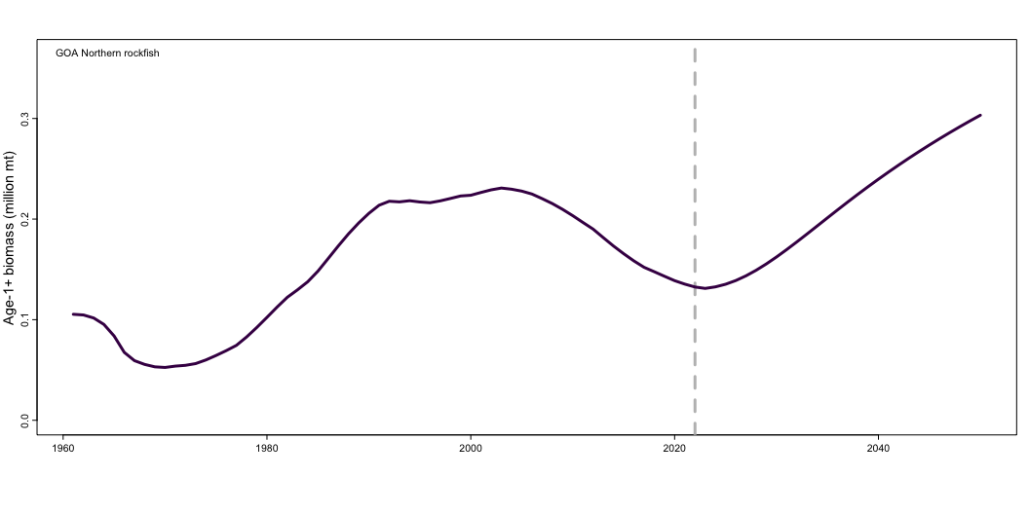
Climate resilience
nrdata$env_data <- data.frame( Year = nrdata$styr:nrdata$projyr, Index = 1:90 * 0.5 + rnorm(90)) om2 <- Rceattle::fit_mod( data_list = nrdata, estimateMode = 0, # Estimate initMode = 1, # Assume unfished equilibrium phase = TRUE, M1Fun = build_M1( updateM1 = TRUE, M1_model = 1, M1_use_prior = TRUE, M_prior = 0.06, M_prior_sd = 0.05), recFun = build_srr( srr_fun = 1, # Mean R with covariates srr_indices = 1), )
[1] "'Age_max_selected_upper' not specified in 'fleet_control', assuming 'NA'" [1] "'Sel_curve_pen1' not specified in 'fleet_control', assuming '0'" [1] "'Sel_curve_pen2' not specified in 'fleet_control', assuming '0'"
plot_biomass(om2, incl_proj = TRUE)

Slide 14
MSE 5
mse5 <- run_mse( om = om2, em = em, nsim = 10, fut_sample = 0.5, assessment_period = 4, sampling_period = c(1, 2) # Fishery = fleet 1, BTS = fleet 2 )

Slide 15
Overall summary
MSE | Species | Fleet_name | Fleet_code | Average Catch | Catch IAV | P(Closed) | Avg SSB Relative MSE | Avg terminal SSB Relative MSE | EM: P(Fy > Flimit) | EM: P(SSB < SSBlimit) | OM: P(Fy > Flimit) | OM: P(SSB < SSBlimit) | EM: P(Fy > Flimit) but OM: P(Fy < Flimit) | EM: P(Fy < Flimit) but OM: P(Fy > Flimit) | EM: P(SSB < SSBlimit) but OM: P(SSB > SSBlimit) | EM: P(SSB > SSBlimit) but OM: P(SSB < SSBlimit) | OM: Terminal B | OM: Terminal SSB | OM: Terminal Dynamic SB0 | OM: Terminal SSB Depletion | OM: Terminal SSB Depletion (Dynamic) | OM: Average SSB Depletion | OM no F: SSB Collapse | OM: SSB Collapse | OM: SSB Collapse from F
1 | GOA Northern rockfish | NA | NA | 4546.83 | 0.07 | 0 | 0.45 | 0.00 | 0 | 0 | 0 | 0 | 0 | 0 | 0 | 0 | 110019.04 | 35363.29 | 78239.95 | 0.38 | 0.45 | 0.39 | 0 | 0 | 0
1 | 1 | Fishery | 2 | 4546.83 | 0.07 | 0 | NA | NA | NA | NA | NA | NA | NA | NA | NA | NA | NA | NA | NA | NA | NA | NA | NA | NA | NA
1 | All | All | All | 4546.83 | 0.07 | NA | NA | NA | NA | NA | NA | NA | NA | NA | NA | NA | NA | NA | NA | NA | NA | NA | NA | NA | NA
2 | GOA Northern rockfish | NA | NA | 5616.23 | 0.08 | 0 | 0.48 | 0.00 | 0 | 0 | 0 | 0 | 0 | 0 | 0 | 0 | 93641.89 | 27614.05 | 78239.95 | 0.30 | 0.35 | 0.32 | 0 | 0 | 0
2 | 1 | Fishery | 2 | 5616.23 | 0.08 | 0 | NA | NA | NA | NA | NA | NA | NA | NA | NA | NA | NA | NA | NA | NA | NA | NA | NA | NA | NA
2 | All | All | All | 5616.23 | 0.08 | NA | NA | NA | NA | NA | NA | NA | NA | NA | NA | NA | NA | NA | NA | NA | NA | NA | NA | NA | NA
2 | GOA Northern rockfish | NA | NA | 4513.70 | 0.07 | 0 | 0.46 | 0.00 | 0 | 0 | 0 | 0 | 0 | 0 | 0 | 0 | 110462.63 | 35591.04 | 78239.95 | 0.38 | 0.45 | 0.39 | 0 | 0 | 0
2 | 1 | Fishery | 2 | 4513.70 | 0.07 | 0 | NA | NA | NA | NA | NA | NA | NA | NA | NA | NA | NA | NA | NA | NA | NA | NA | NA | NA | NA
2 | All | All | All | 4513.70 | 0.07 | NA | NA | NA | NA | NA | NA | NA | NA | NA | NA | NA | NA | NA | NA | NA | NA | NA | NA | NA | NA
2 | GOA Northern rockfish | NA | NA | 4364.35 | 0.08 | 0 | 0.46 | 0.01 | 0 | 0 | 0 | 0 | 0 | 0 | 0 | 0 | 114102.34 | 37321.95 | 78239.95 | 0.40 | 0.47 | 0.39 | 0 | 0 | 0
2 | 1 | Fishery | 2 | 4364.35 | 0.08 | 0 | NA | NA | NA | NA | NA | NA | NA | NA | NA | NA | NA | NA | NA | NA | NA | NA | NA | NA | NA
2 | All | All | All | 4364.35 | 0.08 | NA | NA | NA | NA | NA | NA | NA | NA | NA | NA | NA | NA | NA | NA | NA | NA | NA | NA | NA | NA
mse_summ$MSE = 1 mse_summ2 <- mse_summary(mse2); mse_summ2$MSE = 2 mse_summ3 <- mse_summary(mse3); mse_summ3$MSE = 2 mse_summ4 <- mse_summary(mse4); mse_summ4$MSE = 2 kable(do.call("rbind", list(mse_summ, mse_summ2, mse_summ3, mse_summ4)) %>% dplyr::relocate(MSE), digits = 2)

